Slide 1
STAT 429 Group Project:
Labour Force Participation
Andrew, Joseph, Jonathan
Notes:
Hello, my name is Jonathan and I’m here with Andrew and Joseph. And as the title shows we decided to do our project on labour force participation amongst married women.

Slide 2
Dataset Description
Cross-section data from 1976 Panel Study of Income Dynamics (PSID) based on data for the previous year, 1975.
Labour force participation amongst married women:
0 - “no”
1 - “yes”
Notes:
We grabbed our data from the panel study of income dynamics where they interviewed a bunch of married women in 1975 and recorded the necessary data which we will go into in a couple of slides
Link of the website where we found our data set: https://vincentarelbundock.github.io/Rdatasets/datasets.html
Link of the data set: https://vincentarelbundock.github.io/Rdatasets/doc/AER/PSID1976.html

Slide 3
Research Question
Aside from obvious factors that have an effect on labour force participation in married women, such as years of experience. What other factors from our data set are significant?
Overview of Experiment:
Initial Model (m1)
Interpretive Model (m2)
Predictive Model (m3)
Notes:
Which leads us to our research question, aside from obvious factors that have an effect on labour force participation in married women, such as years of experience. What other factors from our data set determine whether or not married women participate in the labour force?
And just a quick overview on how we will answer this research question. We will show the initial model, the interpretive model where we run variable selection, and just for fun we decided to do a predictive model.

Slide 4
Response and Predictor Variables
Response Variable:
Participation (Factor) = Did the individual participate in the labour force? (0 “no”, 1 “yes”)
Predictor Variables:
youngkids = Number of children less than 6 years old in household
oldkids = Number of children between 6 and 18 in household
age = wife’s age in years
College (Factor) = Did the individual (wife) attend college? (0 “no”, 1 “yes”)
Education = wife’s education in years
Experience = actual years of wife’s previous labour market experience.
Tax = marginal tax rate facing the wife
hcollege (Factor) = did the individual’s husband attend college? (0 “no”, 1 “yes”)
hhours = husband’s hours worked in 1975
hage = husband’s age in years
heducation = husband’s education in years
hwage = husband’s wage, in 1975 dollars
fincome = Family income, in 1975 dollars
Meducation = wife’s mother’s educational attainment, in years
Feducation = wife’s father’s educational attainment, in years
Unemp = unemployment rate in county of residence, in percentage points
City (Factor) = Does the individual live in a large city? (0 “no”, 1 “yes”)
Notes:
Here is the long list of variables we will be working with. Our response variable being the participation denoting labour force participation and a bunch predictor variables, i can quickly describe them as variables pertaining to the wife such as number of children, variables pertaining to the husband, variables such as family income and the wife’s mother, father education.

Slide 5
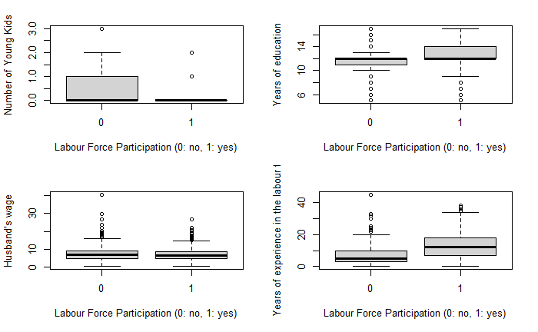
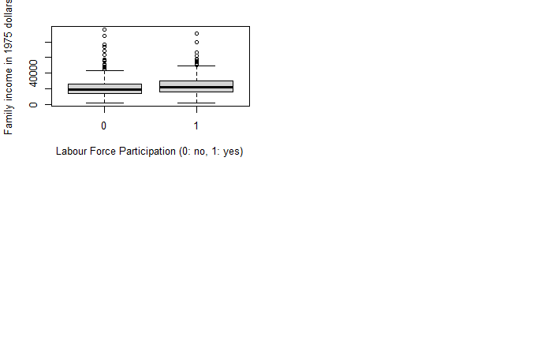
Notes:
Here we have boxplots between labour force participation and some of variables that we initially thought would be significant to the model.
We have here labour force participation and number of young kids, years of education, family income in 1975 dollars, husband’s wage, and years of experience where we can clearly see a difference in the means on whether or not a married woman participates in the labour force

Slide 6
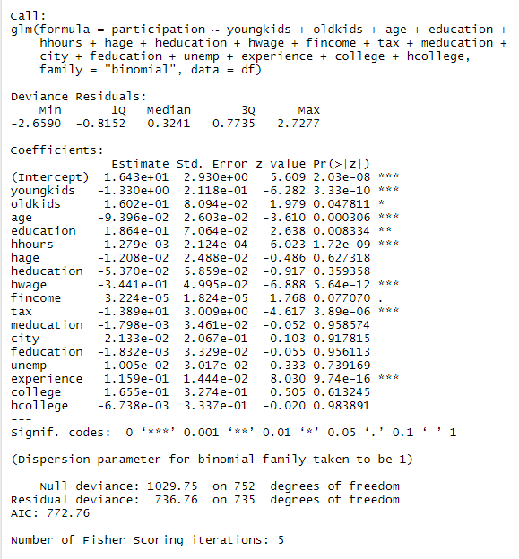
Initial Model (m1)
Notes:
Here is our initial model, we notice that there are quite a bit of variables that arent significant like husbands age, husband’s education, mothers education, etc and all these other variables and so we’ll be running variable selection to essentially find the best model.

Slide 7
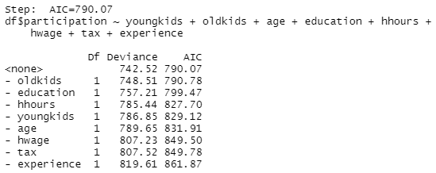
Interpretive Model (m2): Variable Selection
Notes:
So for our first model, we did a stepwise variable selection where we ran a backward elimination based on BIC and these were the predictors that we got. These were the predictors that were deemed significant for the new model.

Slide 8
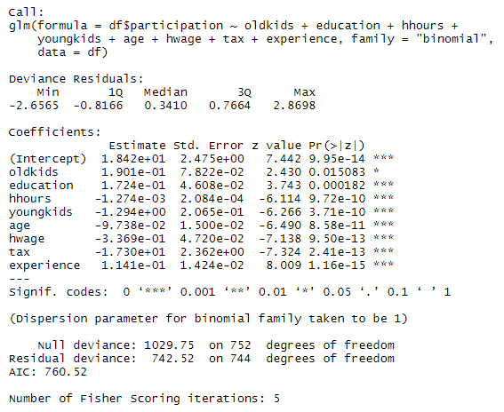
Interpretive Model (m2)
Notes:
And from that method we came up with the new model, m2. This is the summary for m2 and you can see that this model only includes those significant estimators, including experience which we determined to be the most significant variable. This new model also has an AIC of 760.52 which is lower than m1’s AIC (772.76) which indicates that m2 is a better model for our data.

Slide 9
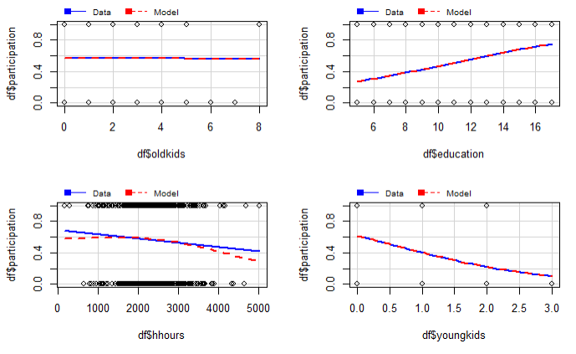
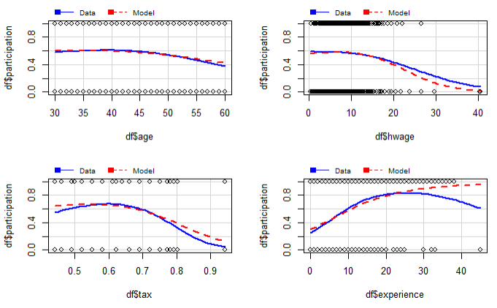
Interpretive Model (m2) : MMPS
Notes:
Here is the marginal model plot of m2 and these graphs represent the predictor variables in m2.

Slide 10
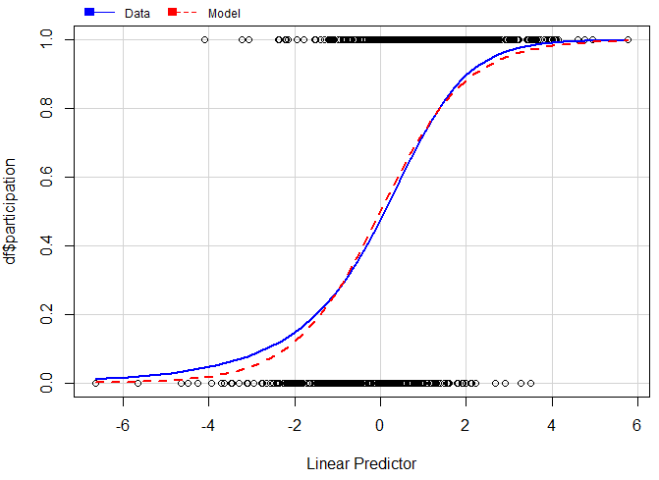
Interpretive Model (m2): Fit
Notes:
And this is the final graph of m2’s marginal model plot and I believe that the x-axis is the combination of all the predictors. Here, we can see that the fit of the model does follow the data.

Slide 11
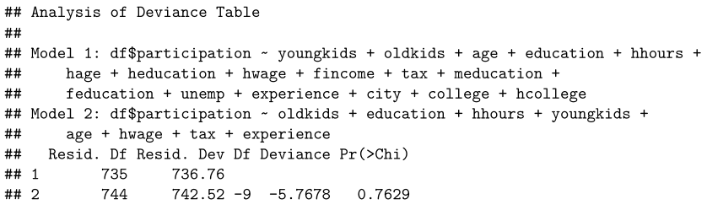
Interpretive Model (m2): Anova
Notes:
Now, another test we ran for this model is the anova test which we ran between m1 and m2 and as you can see the p-value is greater than the critical value of 0.05 so we fail to reject the null hypothesis and we conclude that the predictors that were removed from m1 were indeed not significant which just reiterates the fact that m2 is a better fit for our data.

Slide 12
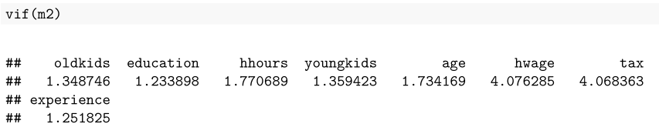
Interpretive Model (m2): Final Thoughts
Log odds of the predictors in the model for the average wife: 0.4047893
Probability of the average wife being in the labour force: 0.5998378
Per 1 year of additional experience, the odds in favour of the wife being in the labour force increased: 1.120833
Notes:
Now, we also ran vif(m2) or the variance inflation factor on m2, we can see that all the values (vif scores) are below 5 which indicates that there is very little multicollinearity between the predictors
We also calculated the log odds of the predictors in the model for the average wife as well as the probability of success which is the probability of the average wife being in the labour force.
Finally, since we determined that experience was the most significant predictor we decided to calculate the odds based on that variable and found that Per 1 year of additional experience, the odds in favour of the wife being in the labour force increased by a multiplicative factor of…

Slide 13
Predictive Model
The goal of this model is to minimize the AIC/BIC so that any prediction/confidence intervals are as tight as possible.
This will be done by:
Attempting all possible transformation
Selecting predictor variables with the all possible subset method
Notes:
And as a little side experiment, we attempt to construct a predictive model in order to minimize AIC/BIC so that any prediction/confidence intervals are as tight as possible.
This will be done by attempting all possible transformations, and selecting predictor variables with the all possible subsets method

Slide 14
Predictive Model: Data Manipulation
Due to the nature of our data, certain variables have 0 as a possible value (not only the dummy ones).
Taking log transformations of this data will results in errors, therefore in order to be able to run the powerTransform() function we must replace the 0 with a small number
All zeros in; # of young kids, # of old kids, # of years of education husband, # of years of education wife, # of years of work experience wife. Were replaced with 10^-5
Notes:
Due to the nature of our data, certain variables have 0 as a possible value (not only the dummy ones).
Taking log transformations of this data will results in errors, therefore in order to be able to run the powerTransform() function we must replace the 0 with a small number

Slide 15
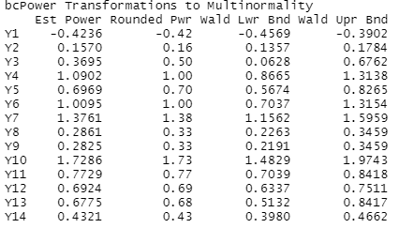
Predictive Model: Transformations
The following transformations were recommended, and then all rounded powers were applied to the data
Note: the response variable and the dummy predictor variables were not transformed because of their binary nature.
Notes:
Only the zeros in the numeric predictors were changed, the dummy variables stayed the same

Slide 16
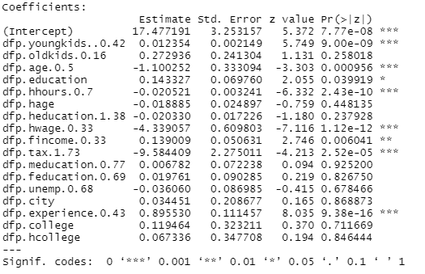
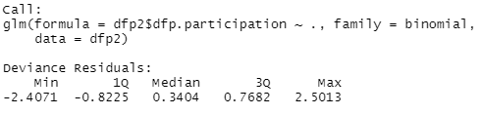
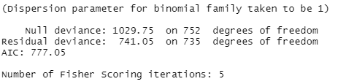
Predictive Model: All Transformations
Notes:
We see a similar amount of significant predictors, however notice that the AIC of this model is worse than the original model.

Slide 17
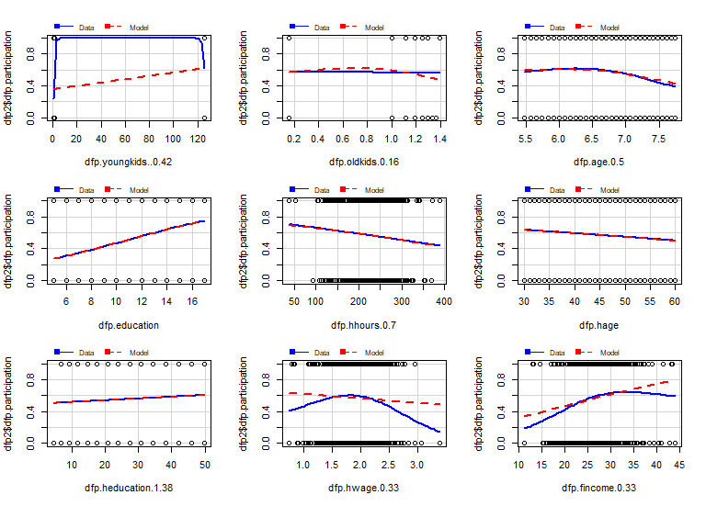
Predictive Model: All Transformations MMP
Notes:
Here are the marginal model plots, we do see that by manipulating the data and turning the 0’s to a really small number, it does mess with some of the plots like for example participation and young kids. Running all the transformations from the powertransform() procedure in the previous slide, we noticed the model doesnt fit the data for certain variables anymore.

Slide 18
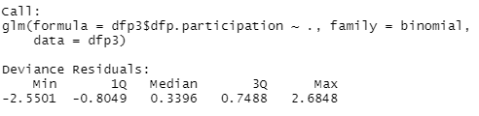
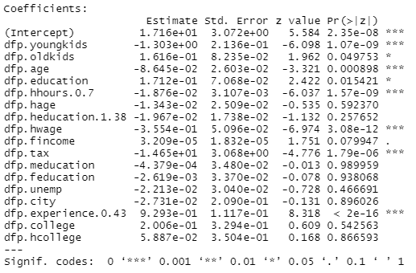
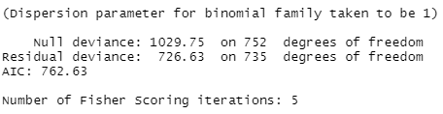
Predictive Model: Only good Transformations
Notes:
So we decided to make another model including only the good transformations such as husband hours, husband education and husband experience. With the AIC of 762.63 being slightly lower than the AIC of 777 for all transformations, and lower than the model with no transformations meaning this was an improvement

Slide 19
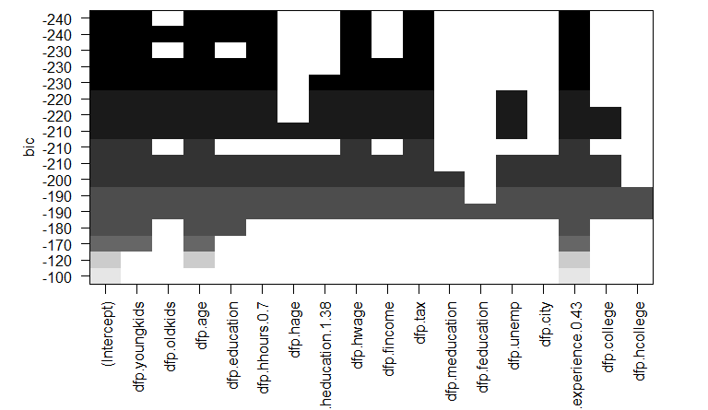
Predictive Model: Variable Selection
Notes:
Here, for doing an exhaustive variable selection method we used the regsubsets command from the leaps package in R to generate this plot. The way to interpret this graph is we consider the upper most row to be the variables used in our final model. So at the top row we have youngkids, age,education,husband hours, husband wage, tax, and experience.
If asked question, this graph represents the best model at a given number of predictors, and then it is ordered from lowest BIC to highest

Slide 20
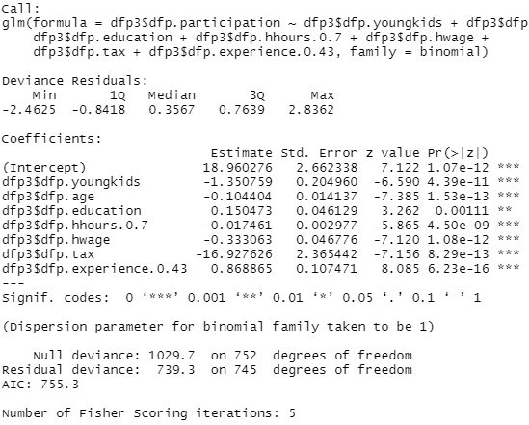
Predictive Model:
Final
Notes:
And now from that variable selection method we construct our final predictive model and notice the AIC is lower at 755.3, with our transformed variables only being that of husband hours and experience.

Slide 21
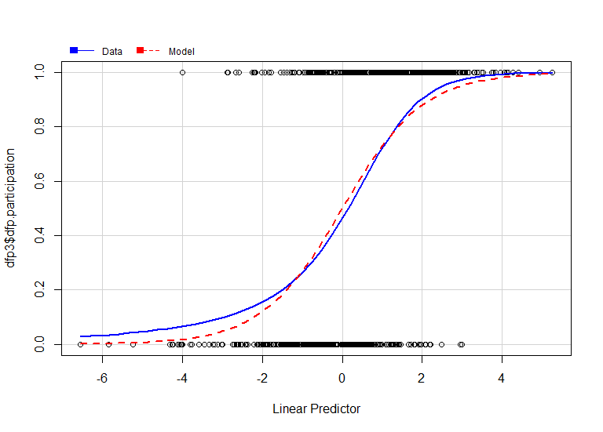
Predictive Model: Fit
Notes:
Here is the marginal model plot of the predictive model. The fit is alright.

Slide 22
Predictive Model: Final Thoughts
Log odd of the average across all predictors: 0.3736192
Probability of being in the labour force for average married woman: 0.5923332
Percent of wives in the labour force: 0.5683931
Notes:
Now to satisfy no multicollinearity our vif scores show that no multicollinearity exists with the log odds of the average across all predictors to be 0.37, the probability of being in the labour force for the average married woman is 0.59. And the percent of wives in the labour force is 0.56
If asked why the 56% number is there: It made sense to look at the real percentage to see if our probability is in the same ballpark as both number should be close to each other but not the same.

Slide 23
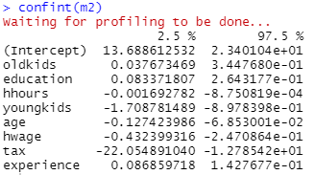
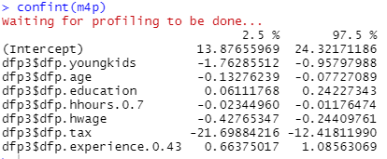
Model Comparisons: Confidence Intervals, AIC
Interpretive Model: Predictive Model:
AIC: 760.52 AIC: 755.3
Notes:
Predictive Model AIC and Interpretive model’s AIC are shown to be very similar. By comparing the two confidence intervals of the predictive and interpretive model its easy to say the predictive has tighter bounds overall, but we see that the interpretive model has tighter bounds for some of the estimators as well. (such as education)

Slide 24
Model Comparisons: Fit
Predictive Model (m3): Interpretive Model (m2):
Notes:
Since we manipulated the data in order to allow the transformation in m3 to be created, we unfortunately can’t compare model 3 with model 2 empirically through anova because the anova() command in R requires that the two models being compared are using the same data. And so we decided to compare them through the MMP and here we see that the interpretive model seems to fit the data better than the predictive model, surprisingly.

Slide 25
Conclusion
The extra transformation and reduced variable count of the predictive model doesn't seem to be effective.
The interpretive model has the upside of being able to understand it and has a better looking fit in the Marginal model plot..
One thing to note: college is not present in both the interpretive model and the predictive model
Notes:
What we found is that the extra transformation and reduced variable count of the predictive model doesn’t seem to be effective (which is kind of why we were never taught to run any sort of power transformations in logistic regression but decided to do it anyways for fun lol)
And to answer our research question: the interpretive model shown here makes intuitive sense in which:
The older the kids, the more education and the more experience, the more likely a married woman will participate in the labour force. Whereas the more hours the husband works, the number of young kids, the older the married woman is, the higher the husbands wage, the higher the tax, the less likely a married woman will participate in the labour force.
One thing to note is that college is not present in both the interpretive and predictive model, we would assume that it would be significant because “higher education leads to more opportunities” but this is not the case.
And that concludes our presentation, and now we’ll open up the floor to questions.

